Slide 1

Adaptive Rejection Metropolis sampling
Computational Statistics report based on:
“Adaptive Rejection Metropolis Sampling within Gibbs Sampling” by W. R. Gilks, N. G. Best and K . K. C. Tan, 1995.
Sara Corrà, Goar Shaboian

Slide 2
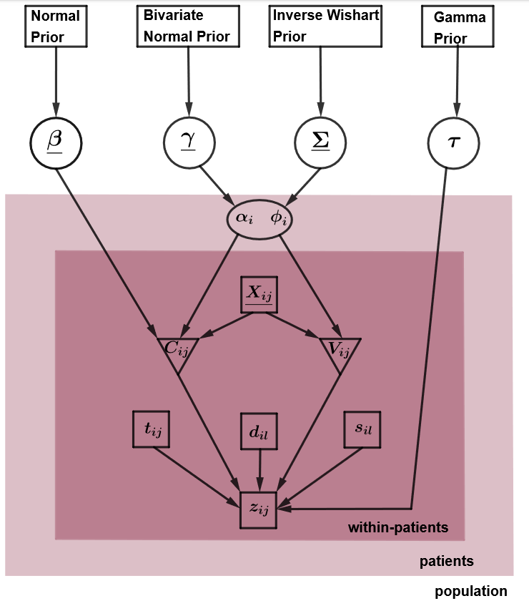
Pharmacokinetics framework
Research conducted to determine the dosage of gentamicin for treating infections in newborns
Observational data prone to noise and measurement error
n = 113.

Slide 3
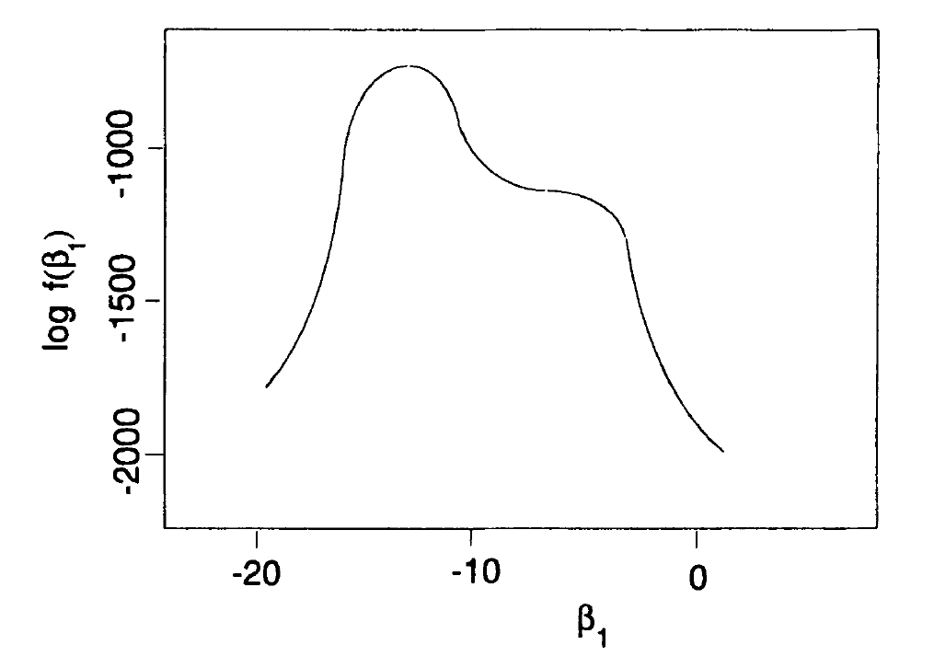
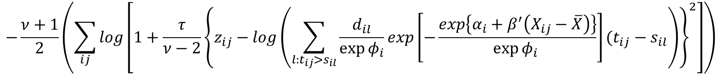
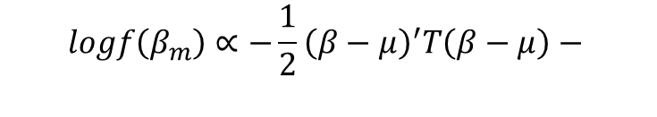
Full conditional for a parameter
Due to complexity of the model and the error structure, the full conditionals distributions have a complicated not log-concave structure and are computationally expensive to evaluate.
$$logf\left(β_{m}\right)∝−\frac{1}{2}{\left(β−μ\right)}^{′}T\left(β−μ\right)−$$
$$−\frac{ν+1}{2}\left(\sum_{ij}{log}\left[1+\frac{τ}{ν−2}{\left\{z_{ij}−log\left(\sum_{l:t_{ij}>s_{il}}{\frac{d_{il}}{\exp{φ_{i}}}exp\left[−\frac{exp\left\{α_{i}+β^{′}\left(X_{ij}−\overline{X}\right)\right\}}{\exp{φ_{i}} }\right](t_{ij}−s_{il}}\right)\right\}}^{2}\right]\right)$$

Slide 4
Algorithm structure
Rejection sampling
Adaptive Rejection sampling (ARS)
To tackle non-log-concave distributions, a complicated algorithm was introduced to produce approximation to the target distribution, implementing rejection sampling methodology and Markov chain Monte Carlo algorithms.
Metropolis-Hastings sampling
Adaptive Rejection Metropolis sampling (ARMS)

Slide 5

Rejection Sampling
The rejection sampling method is based on the strategy of sampling candidates from a distribution that is comparatively easier, followed by adjusting the sampling probability by randomly discarding a subset of the candidates.

Slide 6
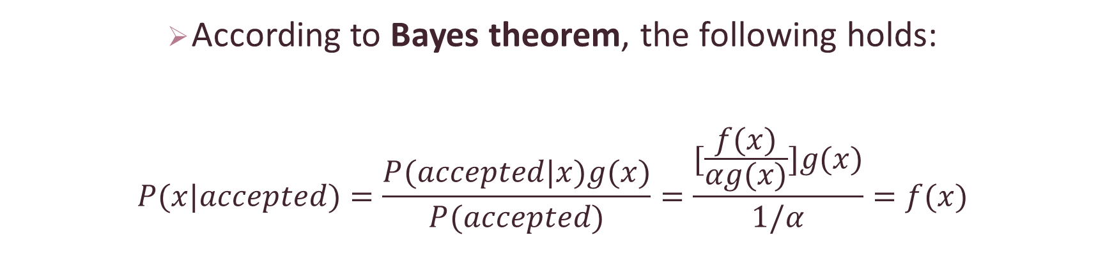
It works because …
According to Bayes theorem, the following holds:
$$P(x|accepted)=\frac{P(accepted|x)g(x)}{P(accepted)}=\frac{[\frac{f(x)}{αg(x)}]g(x)}{1/α}=f(x)$$

Slide 7
Rejection sampling
1. Sample the new value: $X ∼g\left(x\right)$
1. Sample the new value: 𝑋 ∼𝑔(𝑥)
2. Sample a value for random rejection: $U ∼Unif \left(0, 1\right)$
2. Sample a value for random rejection: 𝑈 ∼𝑈𝑛𝑖𝑓 (0, 1)
3. Perform rejection step:
Check U > $\frac{f(X)}{m g(X)}$ {
Check U > (𝑓(X))/(m g(X)) {
reject: • go back to step 1}
else { accept: • set $X_{R}$ = X
else { accept: • set 𝑋_𝑅 = X
4. Return $X_{R}$
4. Return 𝑋_𝑅

Slide 8
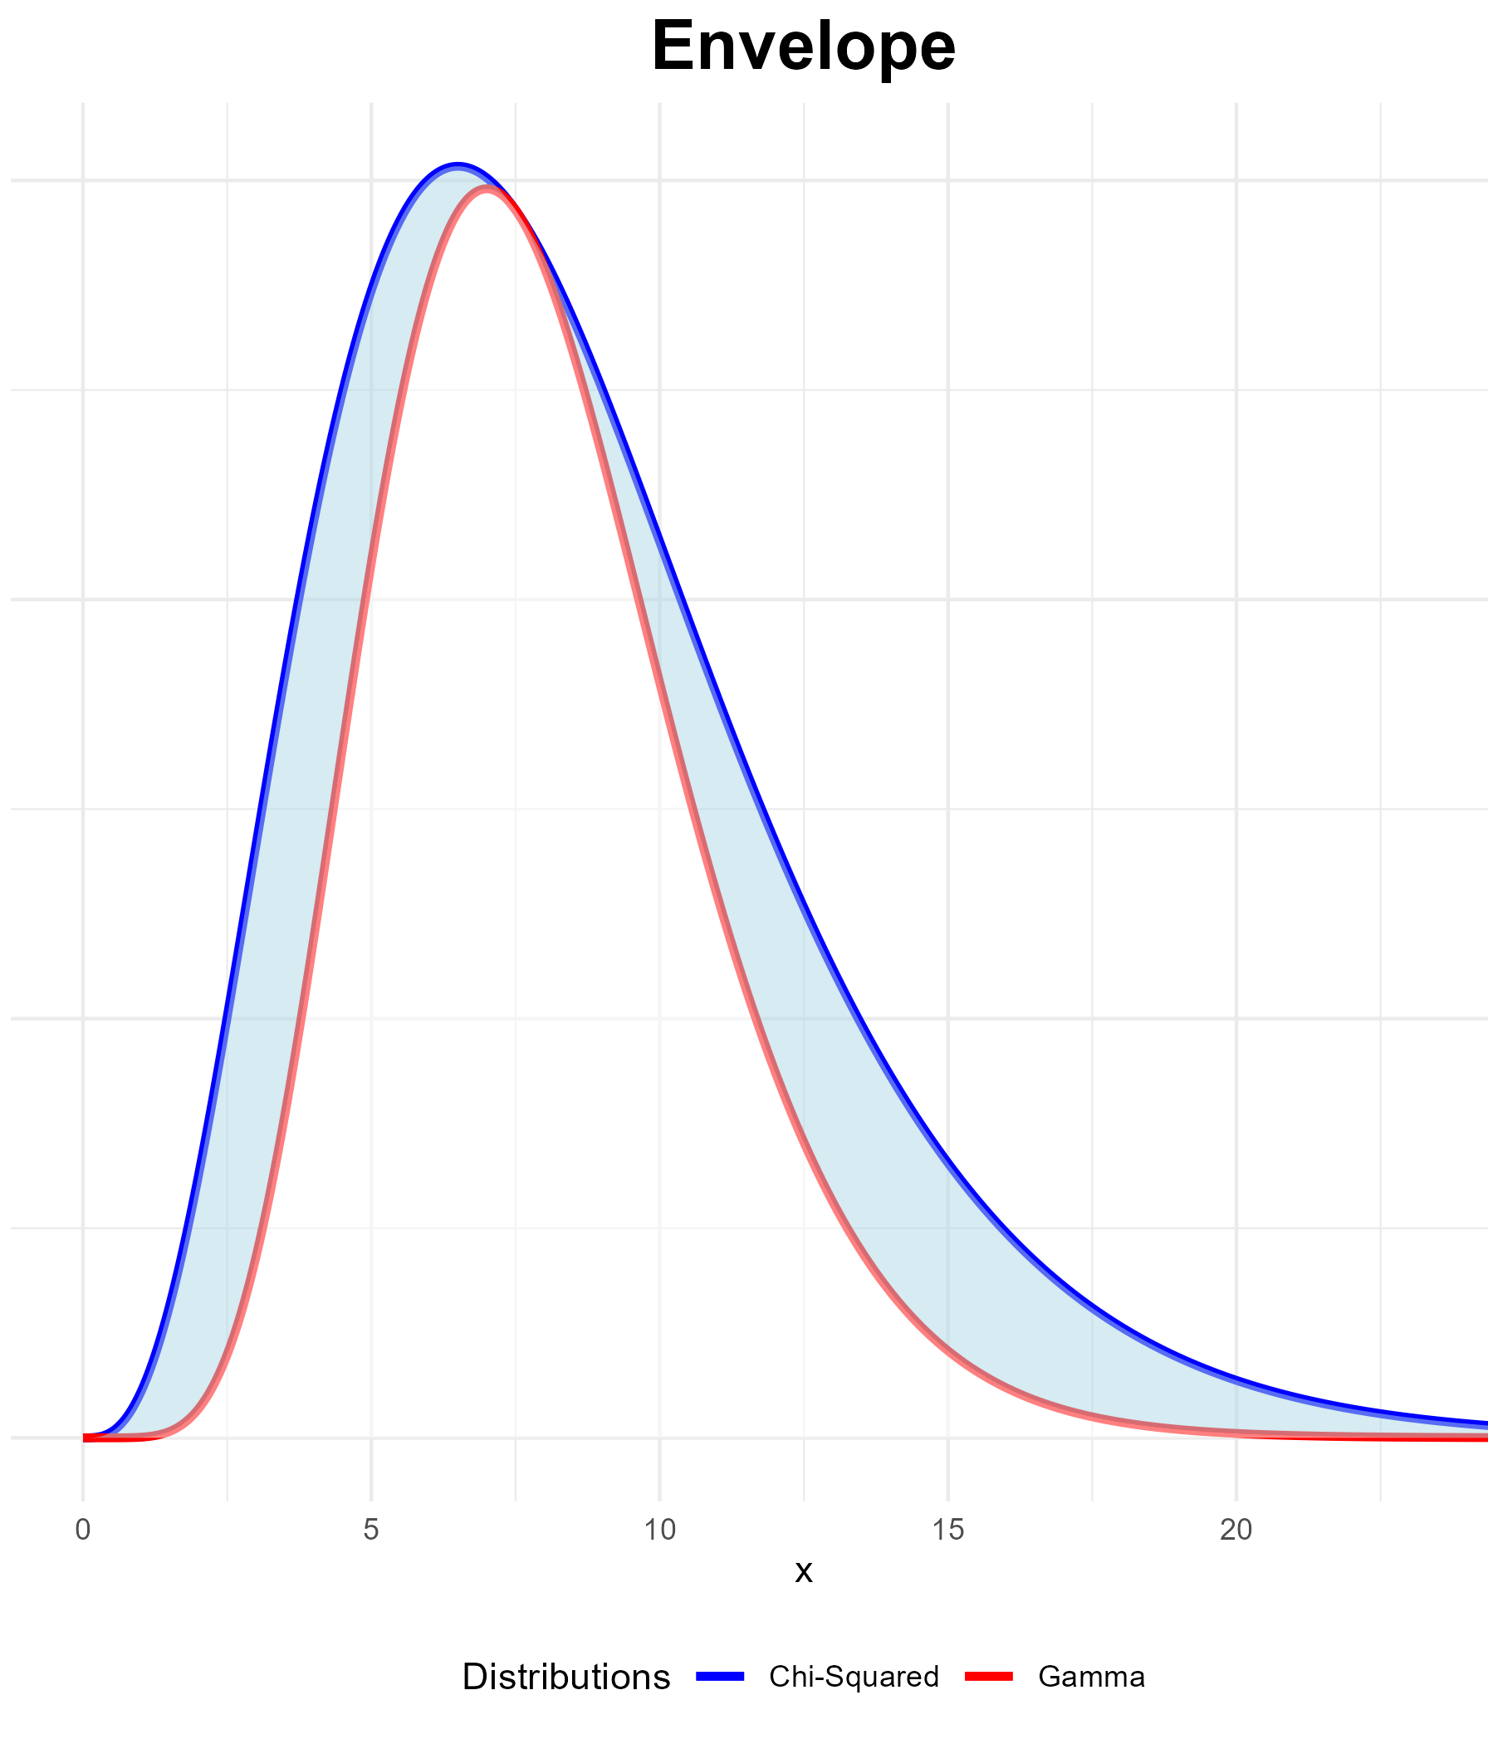

Envelope function
$u>\frac{dGamma\left(x \right| a =8 , b=1)}{α∗ChiSquared\left(x \right| k=8.5)}$
$u>\frac{\frac{b^{a}}{Γ(a)}x^{a−1}e^{−bx}}{α ∗\frac{1}{2^{k/2}Γ(k/2)}x^{\frac{k}{2}−1}e^{−x/2}}$

Slide 9
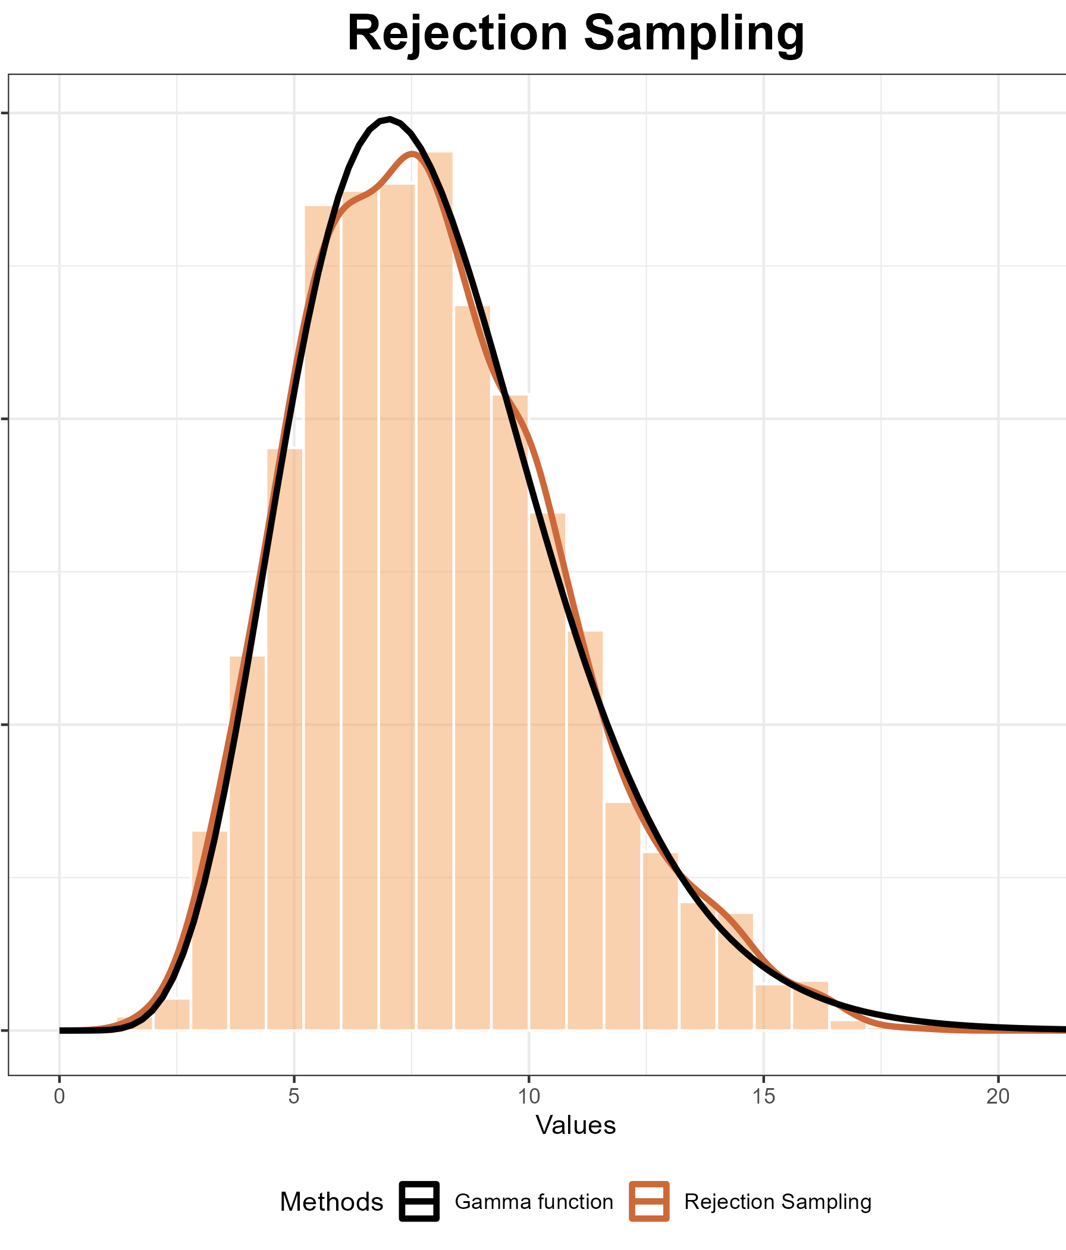
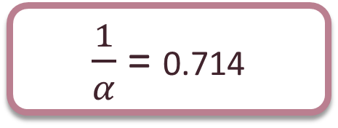
Efficiency
Number of evaluations of the target function: 3000
Sample size: 2139
Acceptance rate:
$\frac{1}{α}$ = 0.714

Slide 10
Adaptive Rejection Sampling
The adaptive nature of this approach is due to the iterative refinement of the envelope and the squeezing function concurrently with the generation of sample draws (by Gilks and Wild).
The relationship can be stated as follows:
By leveraging the property that any concave function can be bounded both from above and below by its secants and chords, the Adaptive Rejection Sampling (ARS) method avoids the need for time consuming optimization.
This derivative-free version of the ARS (Walter R. Gilks and Wild (1992)) uses secants lines avoids the need for the specification of derivatives. Nevertheless, it is important to acknowledge that this advantage comes at the cost of reduced algorithm efficiency.
s(x) ≤ f(x) ≤ h(x)

Slide 11
Log-concave distribution
In domain D, an interval on the real line, a density function $f$ is a log-concave function if it satisfies:
In domain D, an interval on the real line, a density function 𝑓 is a log-concave function if it satisfies:
Fortunately, there is a wide range of functions that are log-concave, making them suitable for the application of the ARS method.
$$ln f\left(a\right)−2ln f\left(b\right)+ln f\left(c\right)<0, ∀ a,b,c∈D; a<b<a$$

Slide 12
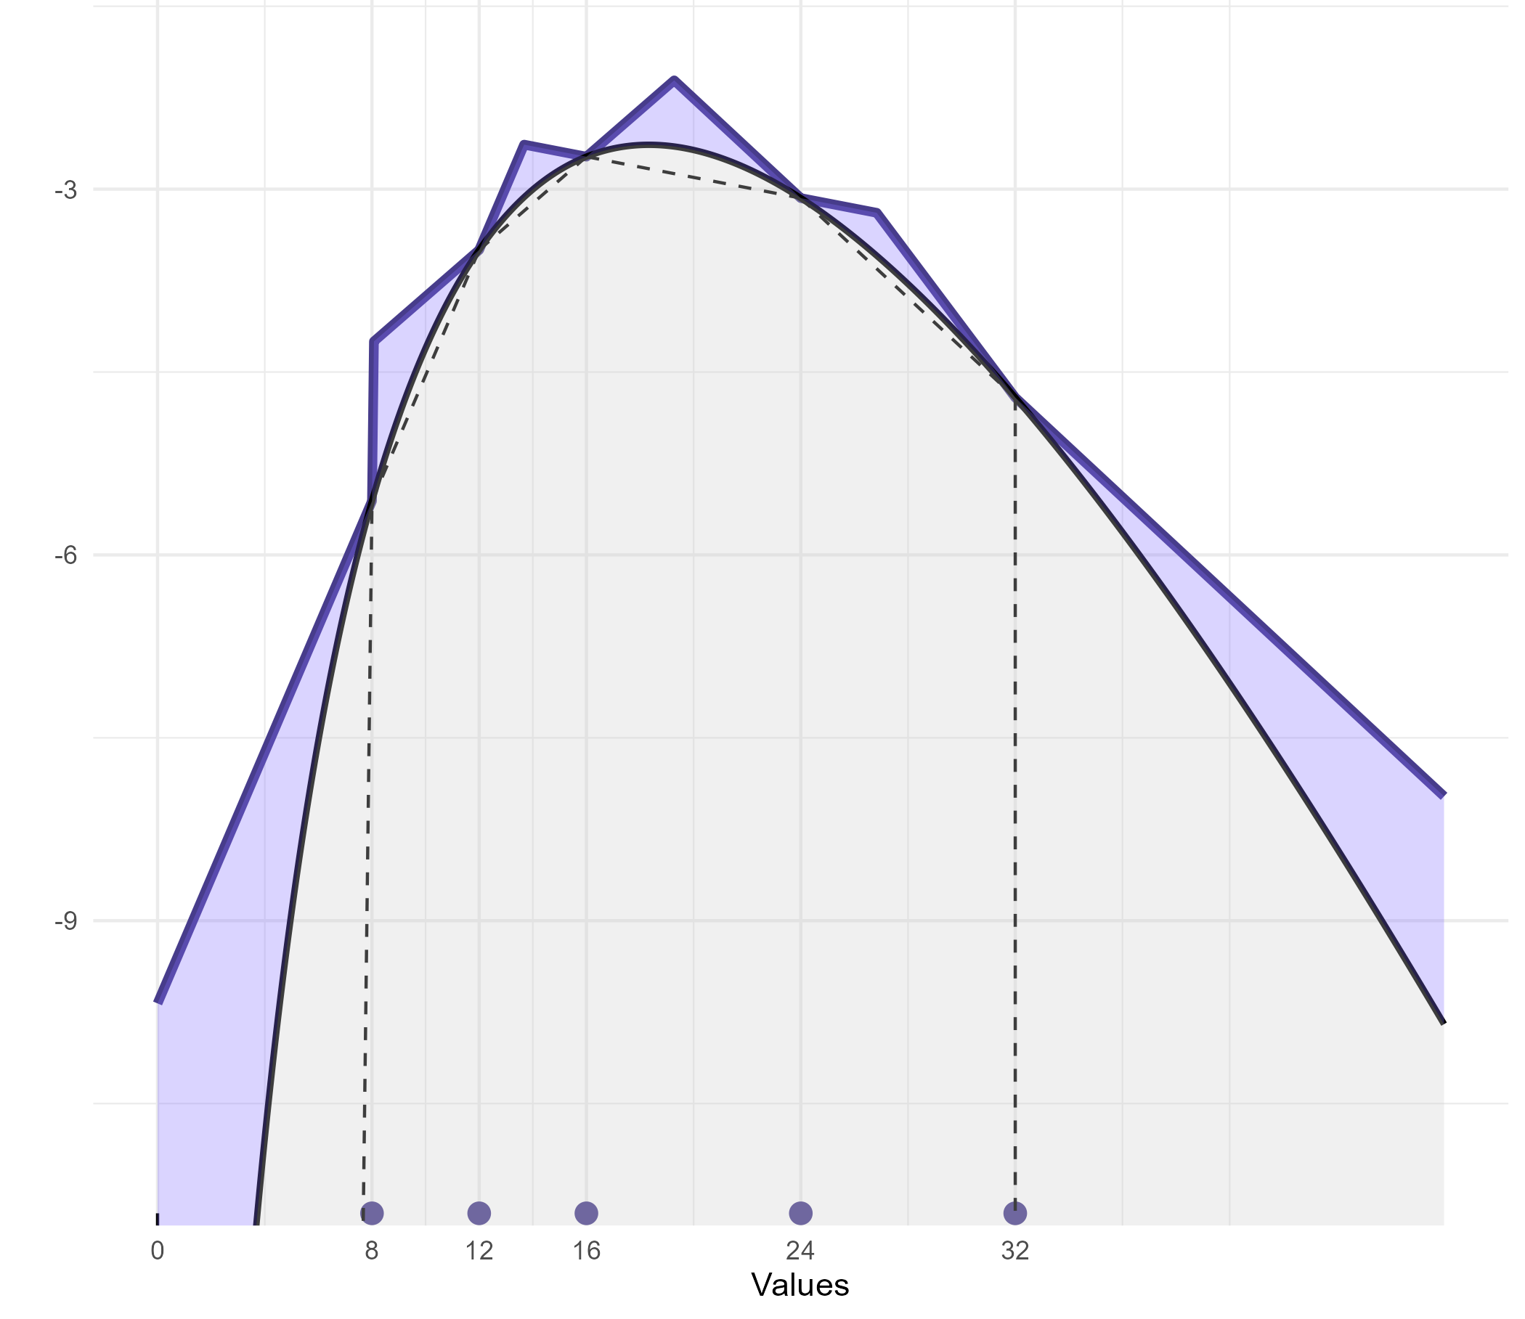

Secant lines
A piecewise envelope constructed using the secant lines is demonstrated, along with the squeezing function.
$$h_{n}(x)=min\left[L_{i−1,i}(x;S_{n}), L_{i+1,i+2}(x;S_{n})\right]$$

Slide 13
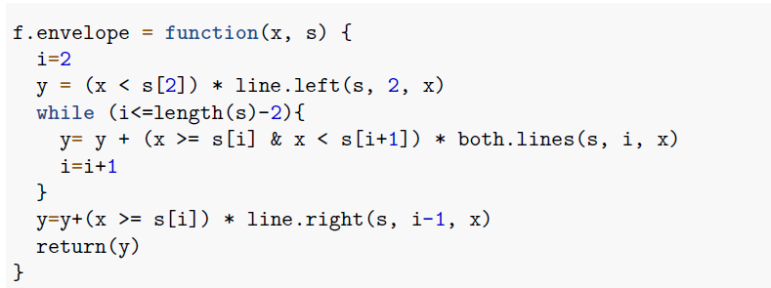
Code for secant lines
After defining the three functions left.line, right.line and both.lines, a while loop is used to construct the actual envelope

Slide 14
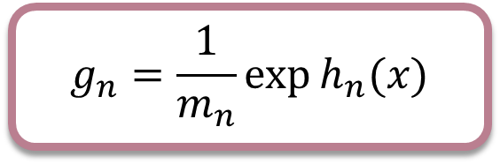

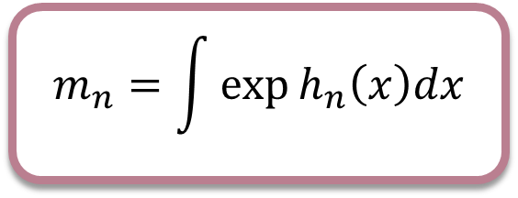
Piecewise exponential linear function
The sampling distribution is given by:
where $m_{n}$ is the normalizing constant of the piecewise exponential distribution given by:
$$g_{n}=\frac{1}{m_{n}}\exp{h_{n}(x)}$$
$$m_{n}=\int{\exp{h_{n}\left(x\right)dx}}$$

Slide 15
ARS algorithm
0. Set initial values for n and $S_{n}$
0. Set initial values for n and 𝑆_𝑛
1. Sample the new value: $X ∼g_{n}(x)$
1. Sample the new value: 𝑋 ∼𝑔_𝑛 (𝑥)
4. Return $X_{R}$
4. Return 𝑋_𝑅
2. Sample a value for random rejection: $U ∼Unif \left(0, 1\right)$
2. Sample a value for random rejection: 𝑈 ∼𝑈𝑛𝑖𝑓 (0, 1)
3. Perform rejection step:
Check $U> \frac{f(X)}{exp h_{n}(X)} \{$
Check 𝑈> (f(X))/(exp ℎ_𝑛 (X)) {
reject: • set $S_{n+1}=S_{n}∪\{X\}$ • set points in $S_{n+1}$ in ascending order
• increment n and return to step 1}}
reject: • set 𝑆_(𝑛+1)=𝑆_𝑛∪{𝑋} • set points in 𝑆_(𝑛+1) in ascending order
• increment n and return to step 1}}
else { accept: • set $x_{A}= X$}
else { accept: • set 𝑥_𝐴= 𝑋 }

Slide 16
ENVELOPE AND SQUEEZING FUNCTION: SEQUENTIAL UPDATING

Slide 17
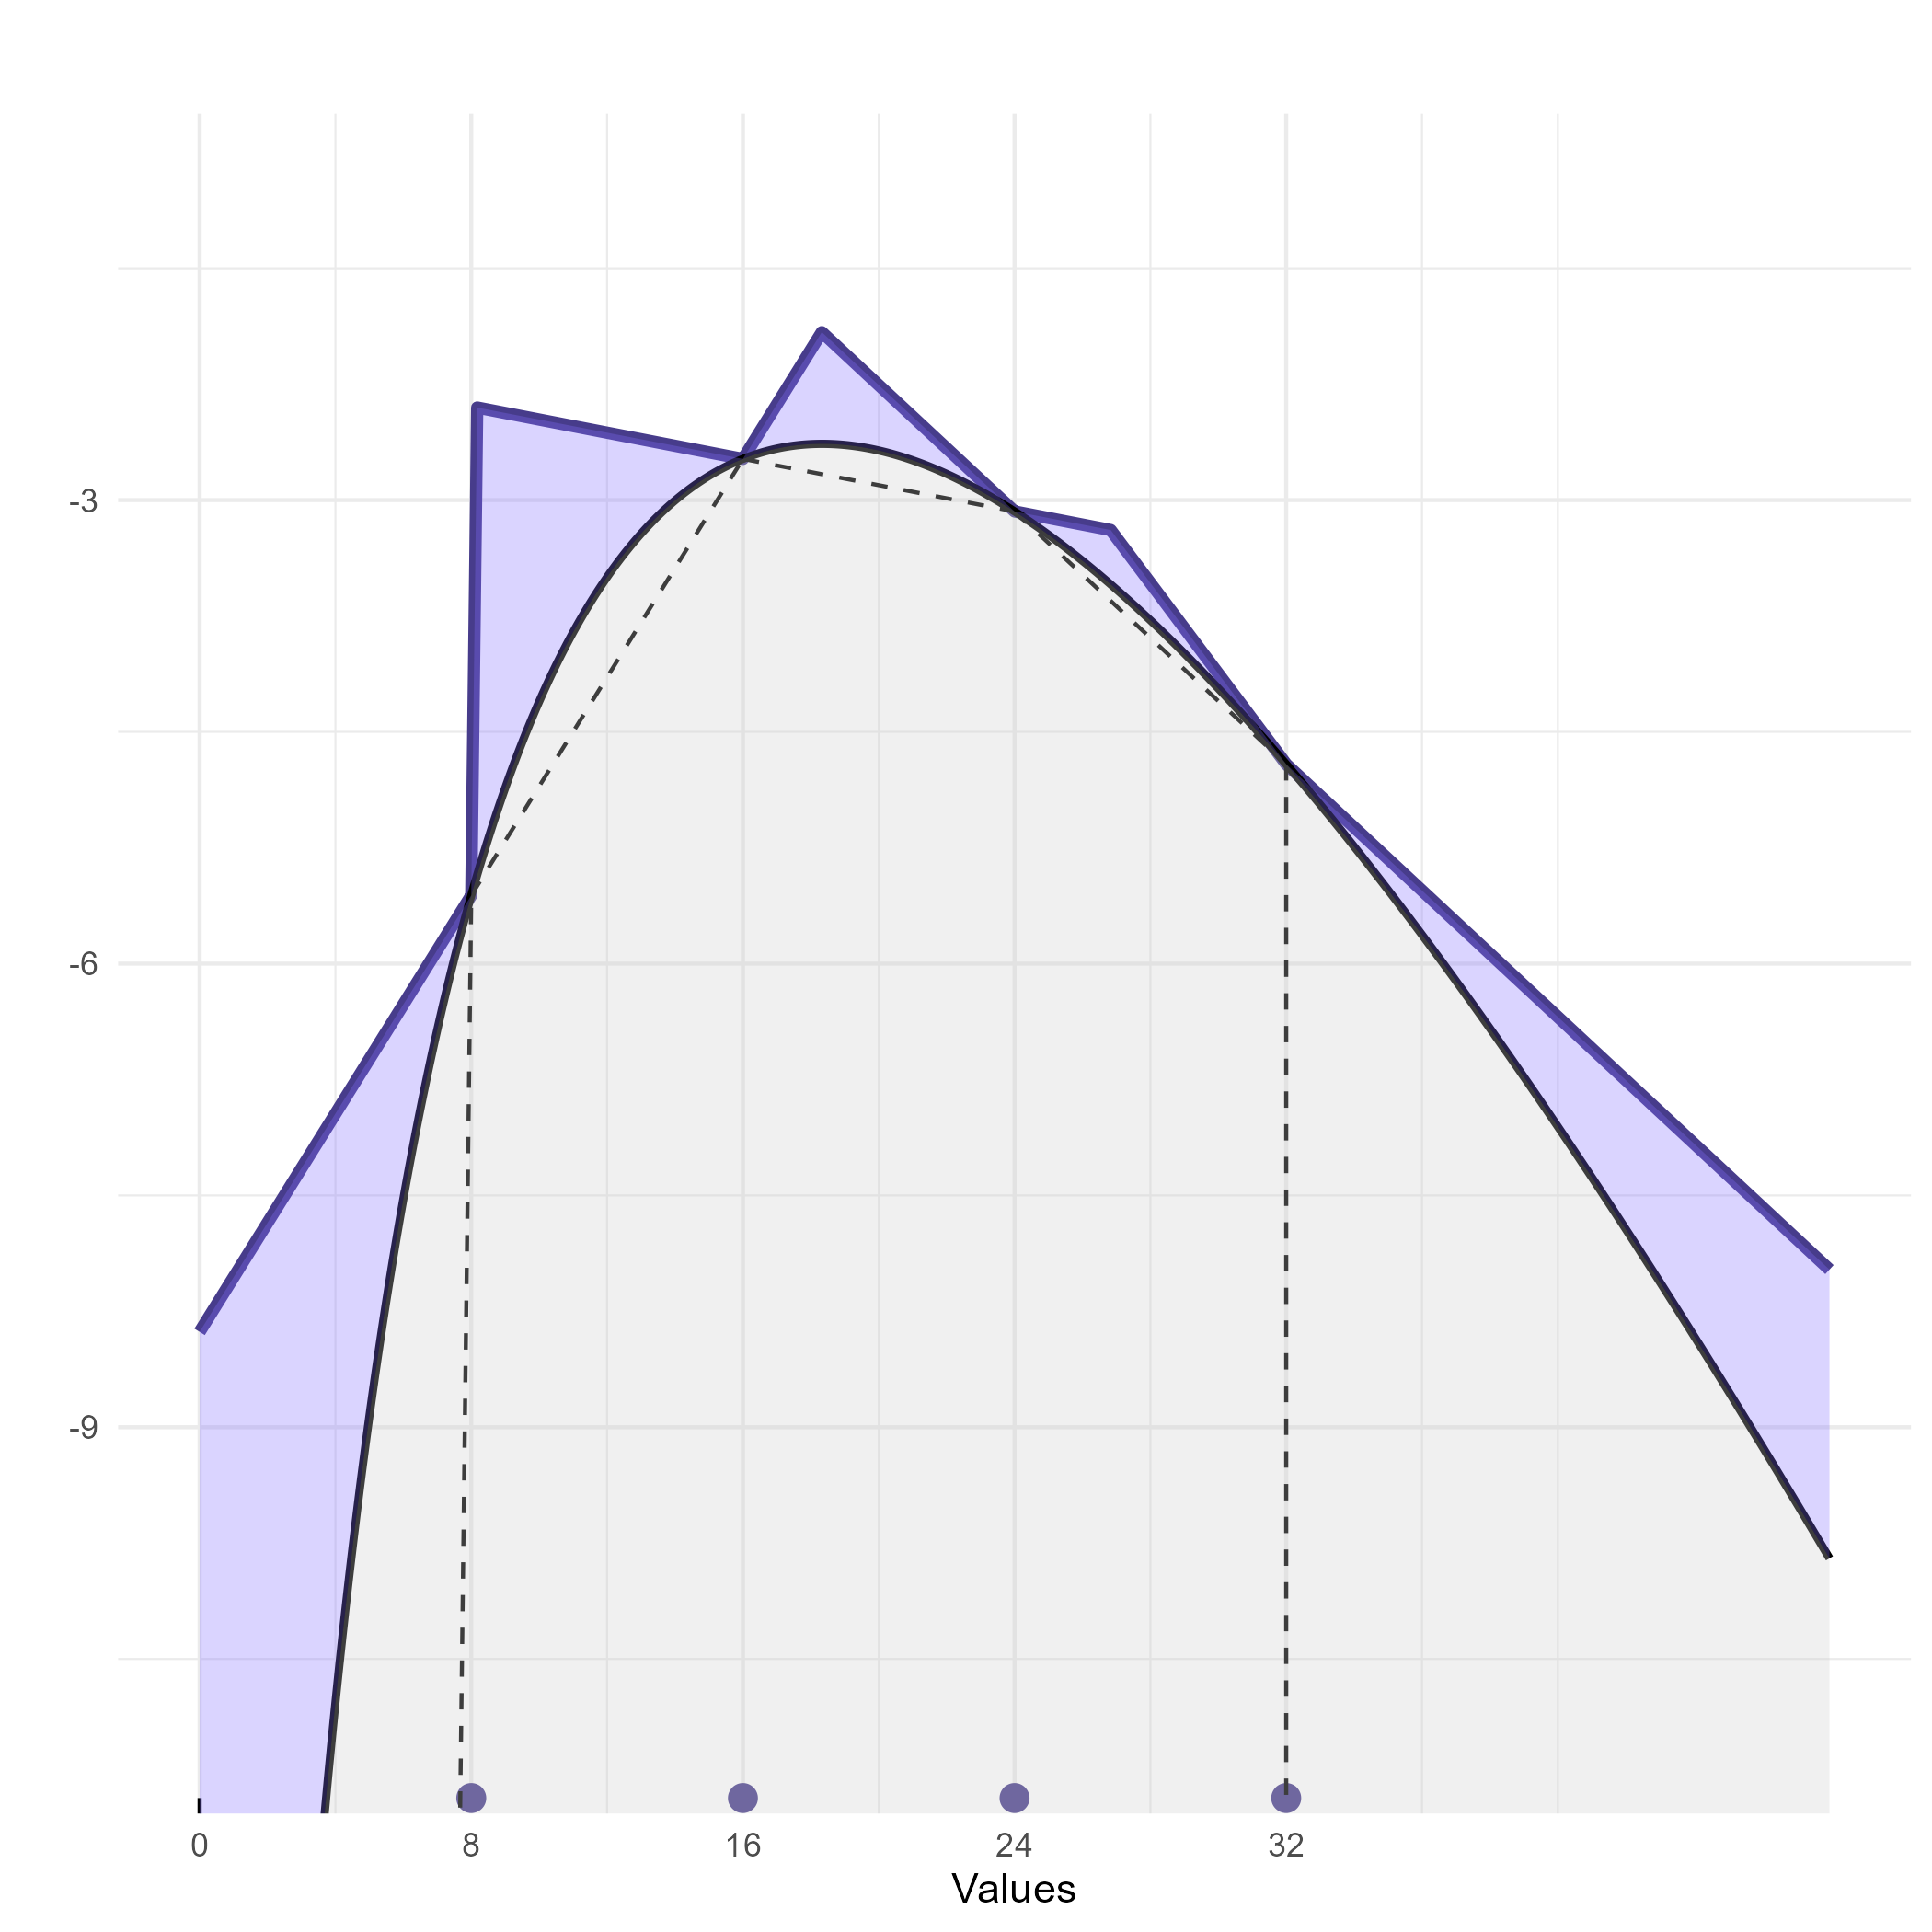
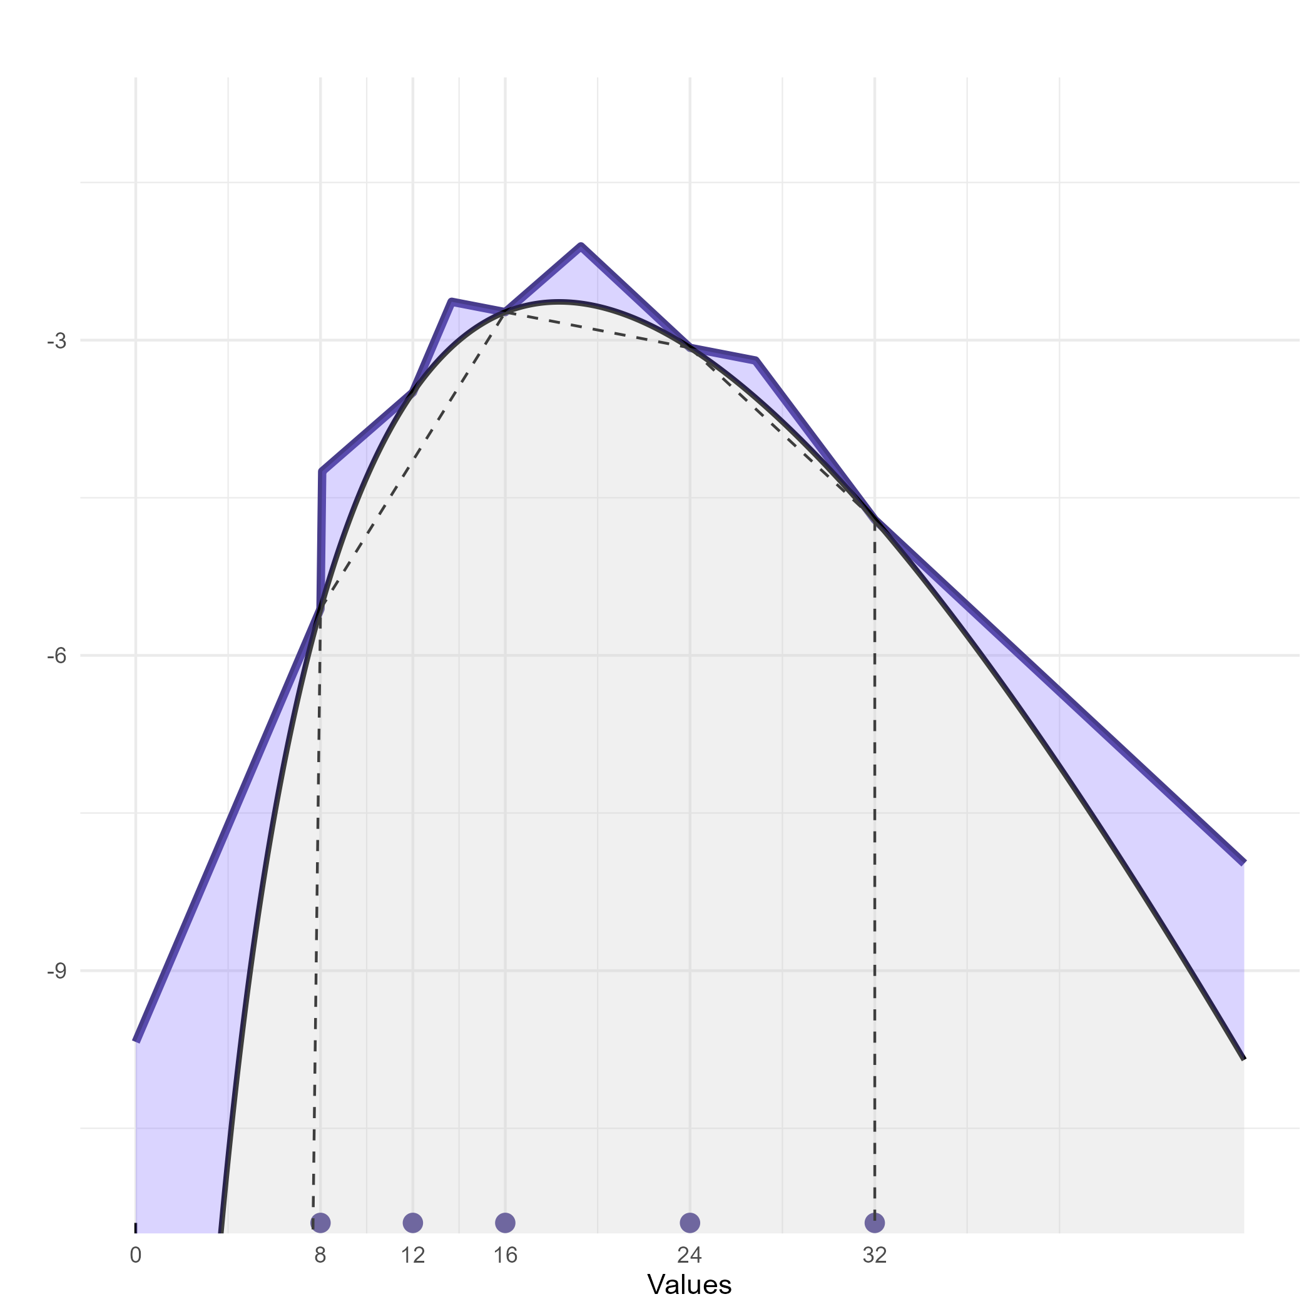
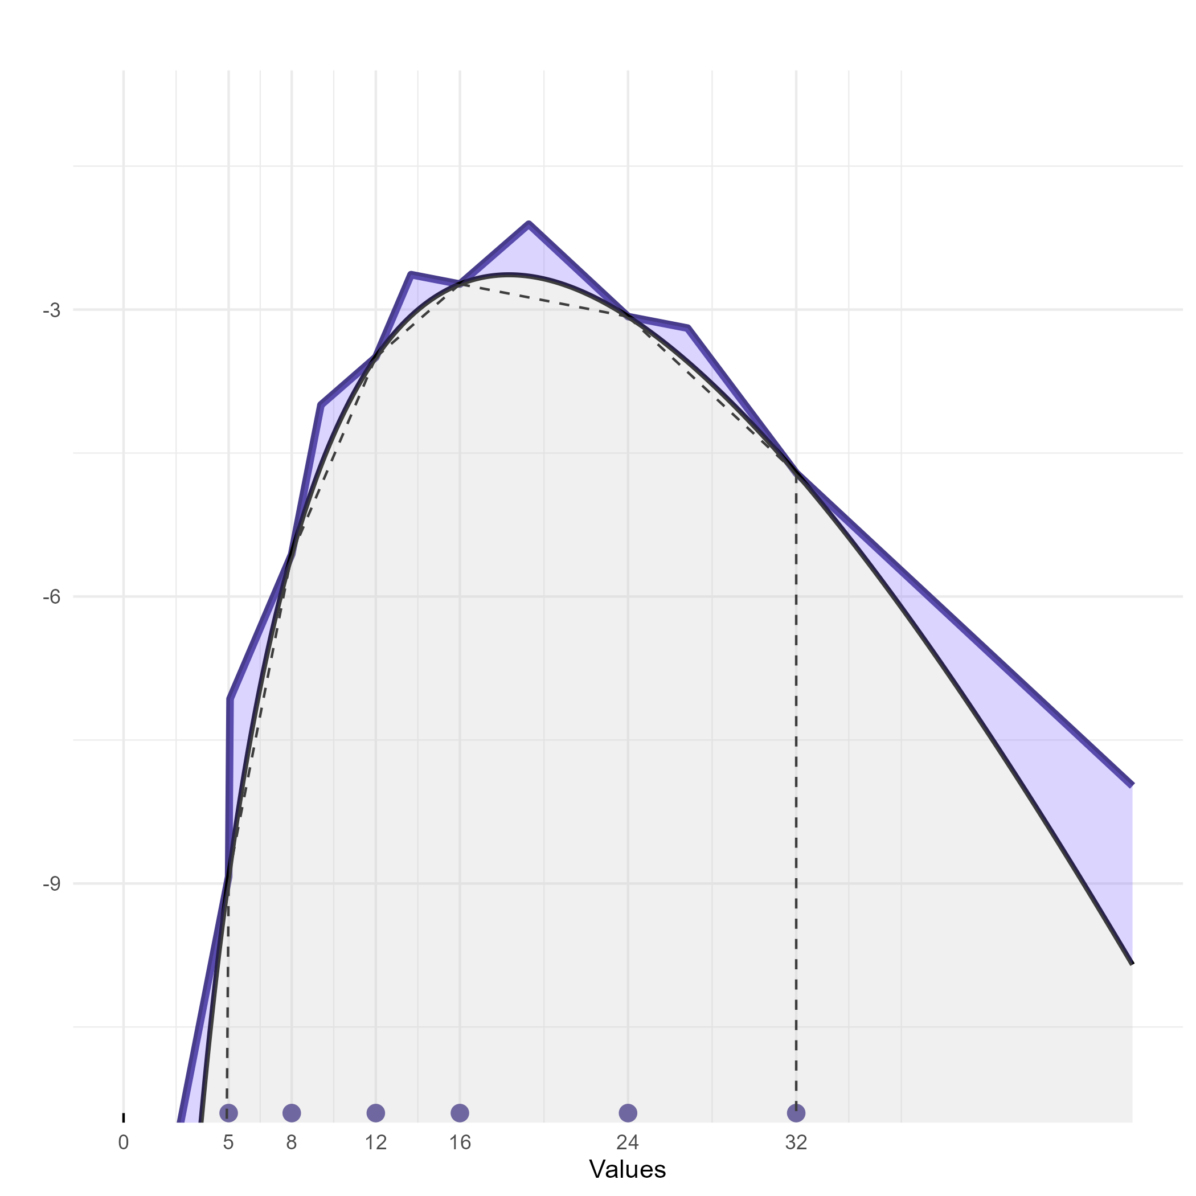

n.points

Slide 18
n.points

Slide 19
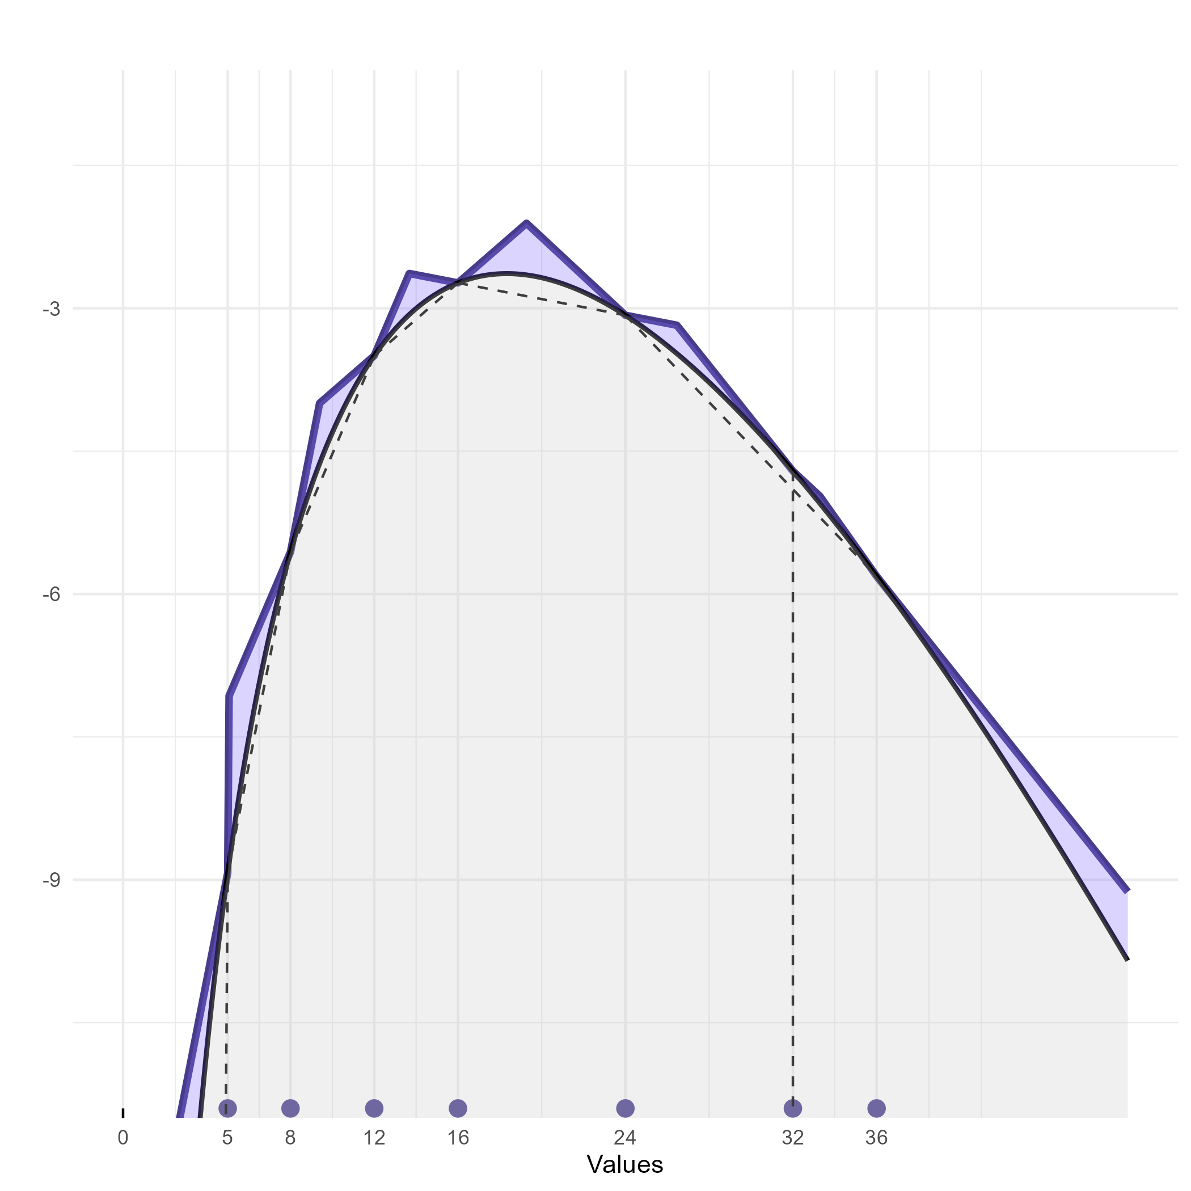
n.points

Slide 20
n.points

Slide 21
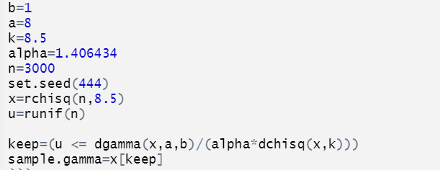
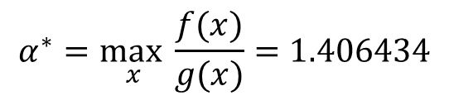
Rejection Sampling in R
$$α^{∗}=\max_{x}{\frac{f(x)}{g(x)}}=1.406434$$

Slide 22

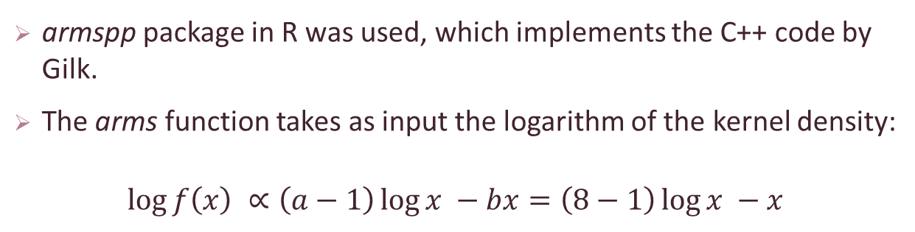
ARS in R
armspp package in R was used, which implements the C++ code by Gilk.
The arms function takes as input the logarithm of the kernel density:
$$\log{f\left(x\right) ∝\left(a−1\right)\log{x −bx=\left(8−1\right)\log{x −x}}}$$

Slide 23
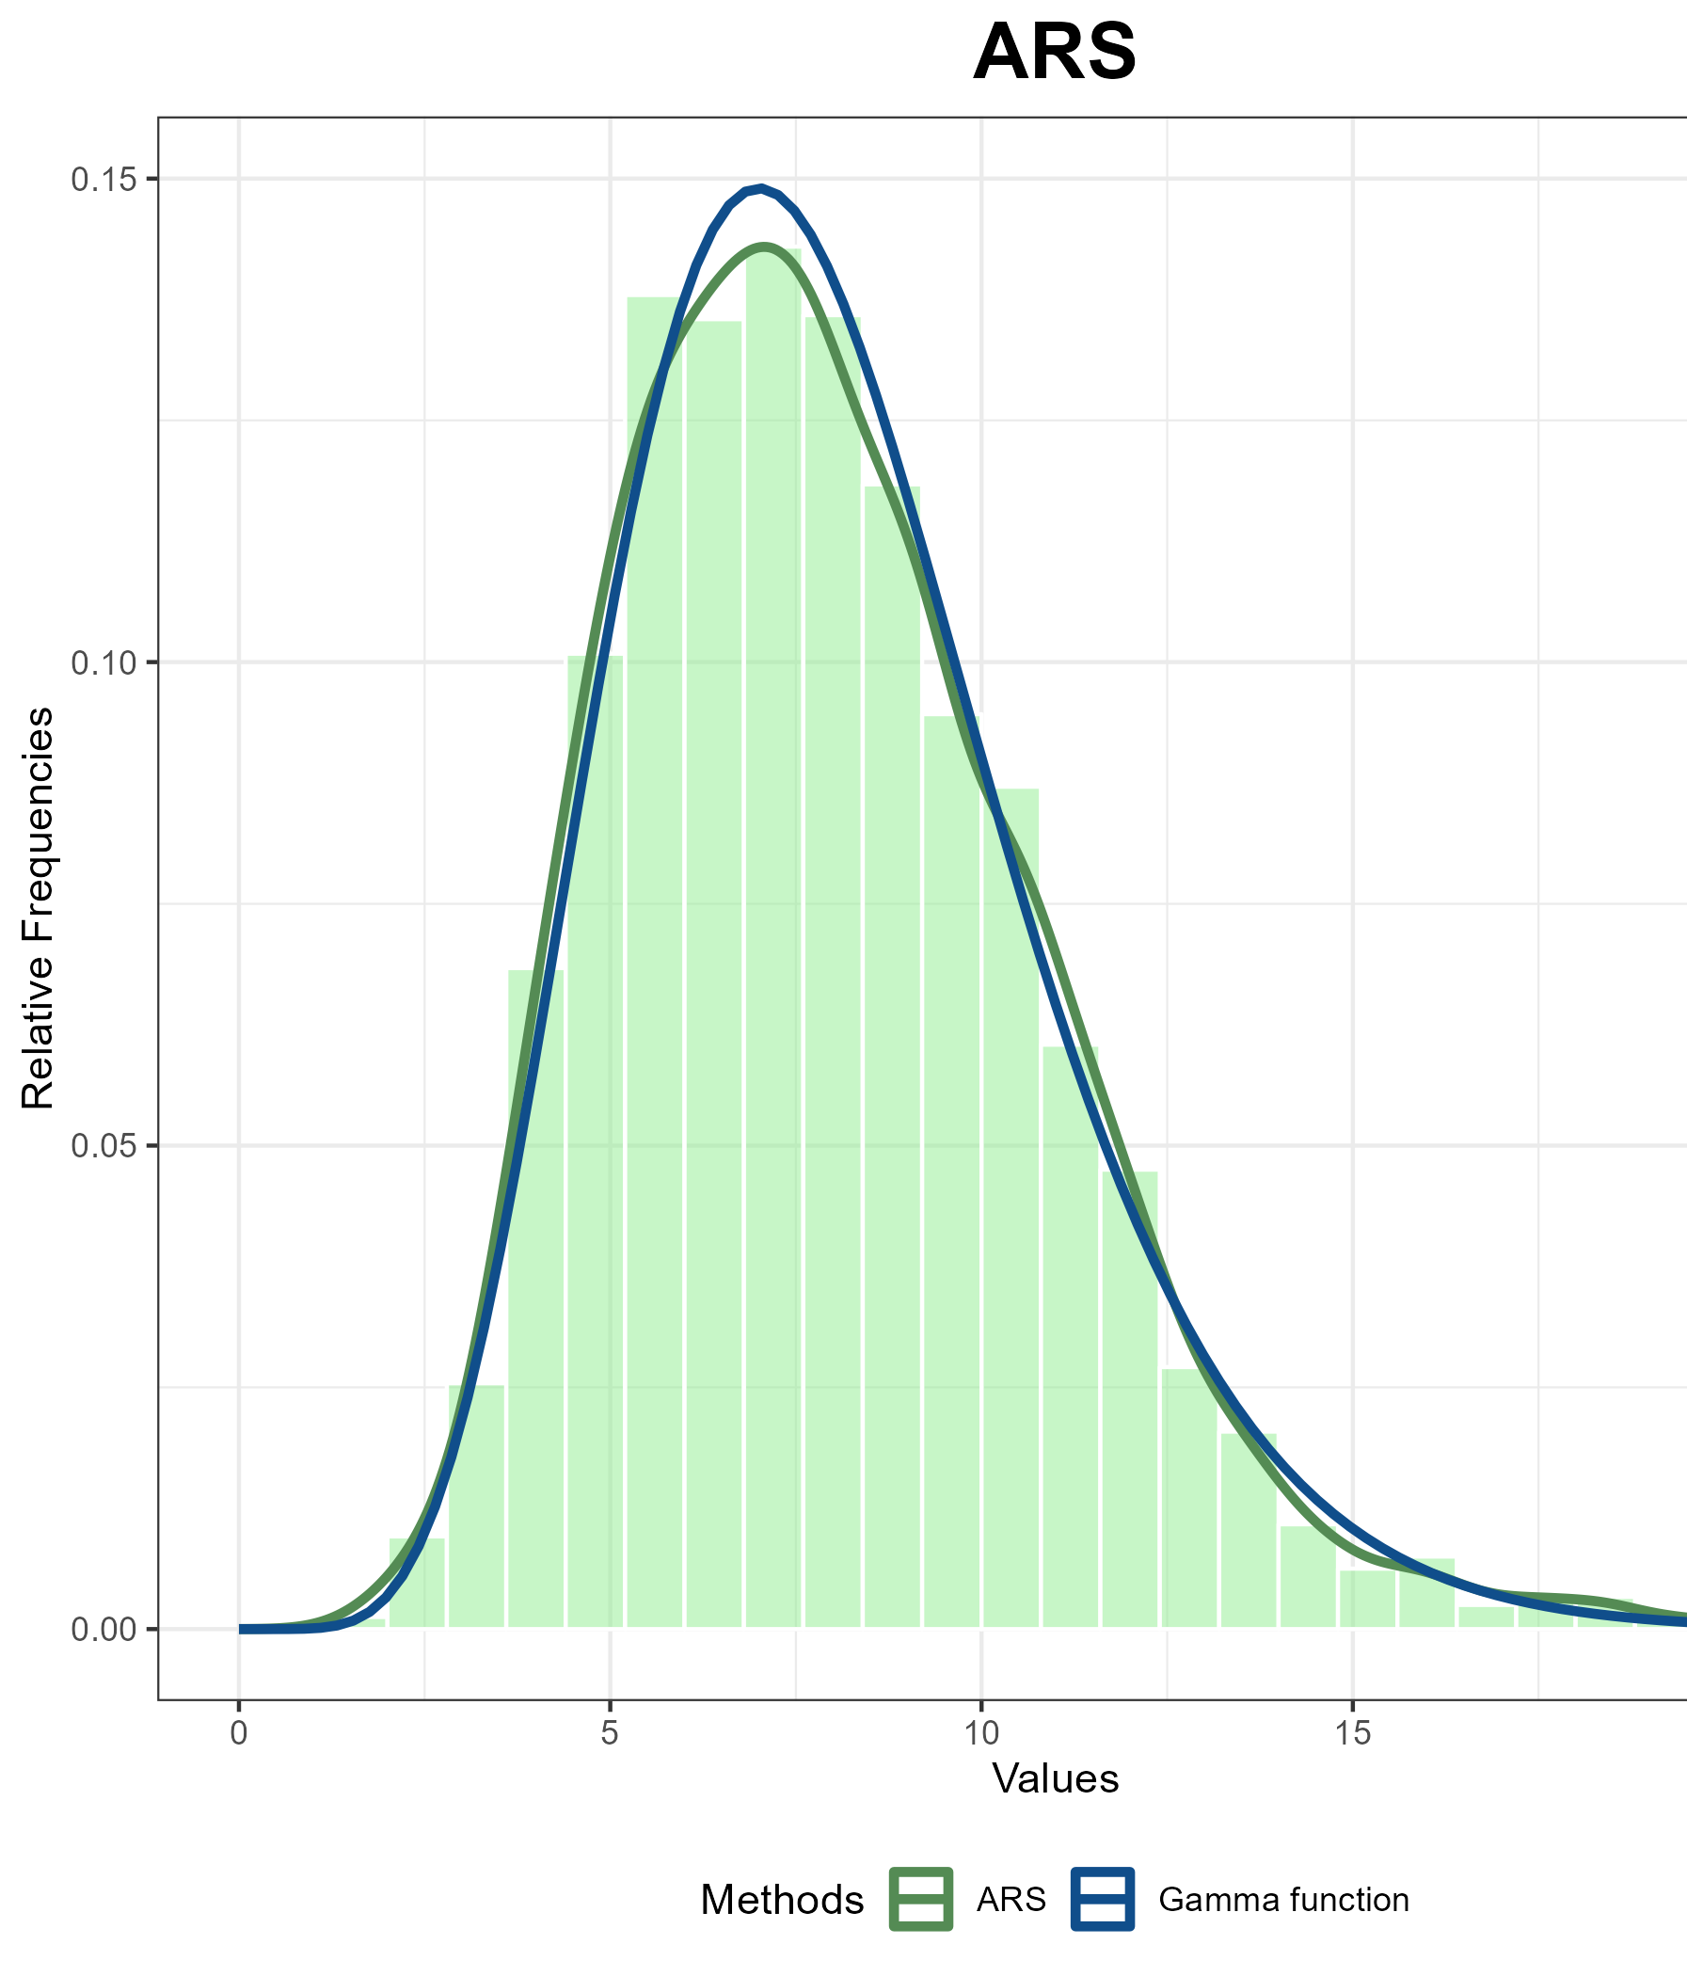
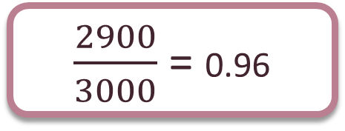
Efficiency
Number of evaluations of the target function: 100
Sample size: 2900
Acceptance rate:
$\frac{2900}{3000}$ = 0.96

Slide 24
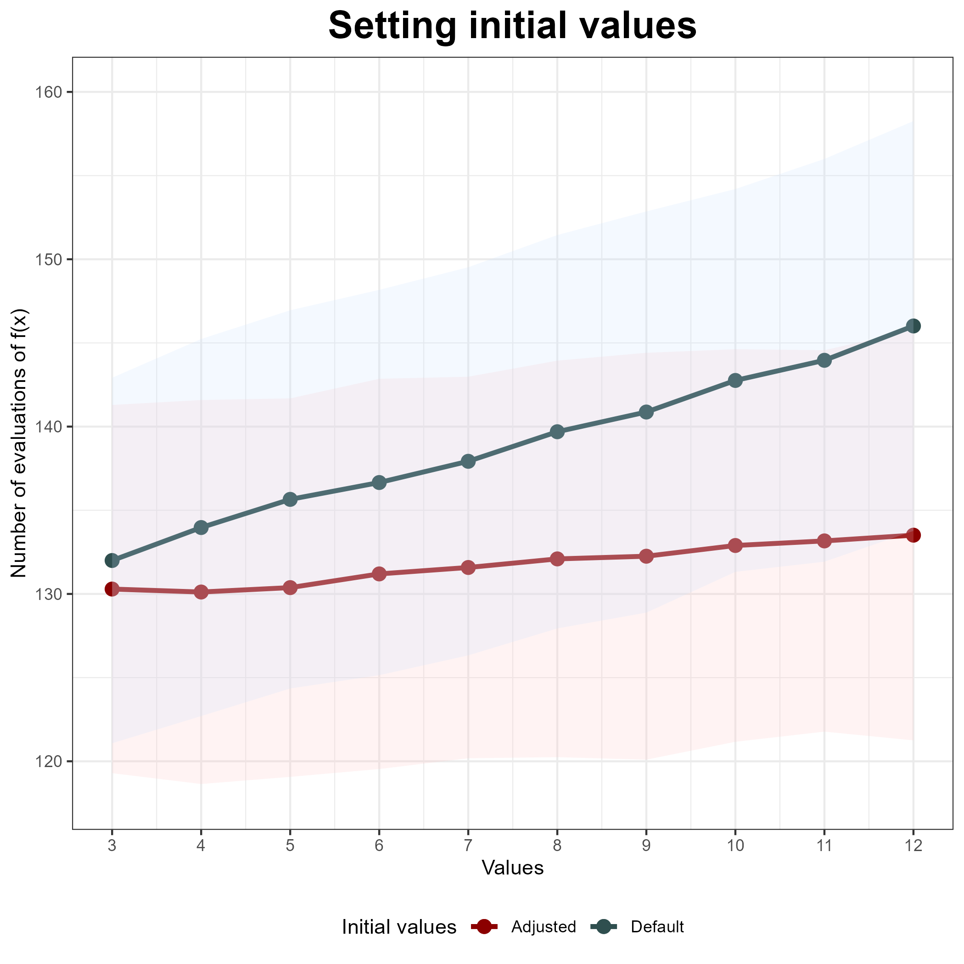
Adjustment of the initial values
Using initial values derived from the quantiles of the desired distribution leads to a reduction in the number of required evaluations.

Slide 25
Metropolis Hastings algorithm
0. Set initial value $x_{0}$
0. Set initial value 𝑥_0
1. Sample the new value: $X ∼q \left(x | x_{i}\right)$
1. Sample the new value: 𝑋 ∼𝑞 (𝑥 │𝑥_𝑖 )
4. Return $X_{MH}$
4. Return 𝑋_𝑀𝐻
2. Sample a value for random rejection: $U ∼Unif \left(0, 1\right)$
2. Sample a value for random rejection: 𝑈 ∼𝑈𝑛𝑖𝑓 (0, 1)
3. Perform rejection step:
Calculate acceptance ratio: $r=\frac{f\left(X\right)q(x_{i}|X)}{f\left(x_{i}\right)q(X|x_{i})}$
Calculate acceptance ratio: 𝑟=(𝑓(𝑋)𝑞(𝑥_𝑖 |𝑋))/(𝑓(𝑥_𝑖 )𝑞(𝑋|𝑥_𝑖))
Check $U >\min\left(1, r\right) \{$
Check 𝑈 >min⁡(1, 𝑟) {
reject: set $x_{MH}= x_{i}$ }
reject: set 𝑥_𝑀𝐻= 𝑥_𝑖 }
else { accept: set $x_{MH}= X$}
else { accept: set 𝑥_𝑀𝐻= 𝑋 }

Slide 26
ARMS algorithm
0. Initialize $n$ and $S_{n}$
0. Initialize 𝑛 and 𝑆_𝑛
1. Sample the new value: $X ∼g_{n} \left(x | x_{i}\right)$
1. Sample the new value: 𝑋 ∼𝑔_𝑛 (𝑥 │𝑥_𝑖 )
4. Sample a value for random rejection: $U ∼Unif \left(0, 1\right)$
4. Sample a value for random rejection: 𝑈 ∼𝑈𝑛𝑖𝑓 (0, 1)
2. Sample a value for random rejection: $U ∼Unif \left(0, 1\right)$
2. Sample a value for random rejection: 𝑈 ∼𝑈𝑛𝑖𝑓 (0, 1)
3. Perform ARS rejection step:
Check $U >\frac{f(X)}{\exp{(h_{n}\left(X\right))}} \{$
Check 𝑈 >(𝑓(𝑋))/exp⁡〖(ℎ_𝑛 (𝑋))〗 {
reject: • set $S_{n+1}=S_{n}∪\{X\}$ • set points in $S_{n+1}$ in ascending order
• increment n and return to step 1}
reject: • set 𝑆_(𝑛+1)=𝑆_𝑛∪{𝑋} • set points in 𝑆_(𝑛+1) in ascending order
• increment n and return to step 1}
else { accept: • set $X_{A}= X$}
else { accept: • set 𝑋_𝐴= 𝑋 }
else { accept: • set $X_{M}= X_{A}$}
else { accept: • set 𝑋_M= 𝑋_A }
Calculate acceptance ratio: $r= \frac{f\left(X_{A}\right)\min{\{f \left(X_{cur}\right), \exp{h_{n}(X_{cur})\}}}}{f\left(X_{cur}\right)\min{\{f \left(X_{A}\right), \exp{h_{n}(X_{A})\}}}}$
Calculate acceptance ratio: 𝑟= (𝑓(𝑋_𝐴 ) min⁡〖{𝑓 (𝑋_𝑐𝑢𝑟 ), exp⁡〖ℎ_𝑛 (𝑋_𝑐𝑢𝑟)}〗 〗)/(𝑓(𝑋_𝑐𝑢𝑟 ) min⁡〖{𝑓 (𝑋_𝐴 ), exp⁡〖ℎ_𝑛 (𝑋_𝐴)}〗 〗 )
Check $U >\min\left\{1, r\right\}$ {
Check 𝑈 >min⁡{1, 𝑟} {
reject: • set $X_{M}= X_{cur}$ }
reject: • set 𝑋_𝑀= 𝑋_𝑐𝑢𝑟 }
5. Perform Metropolis-Hastings rejection step:
6. Return $X_{M}$
6. Return 𝑋_𝑀

Slide 27
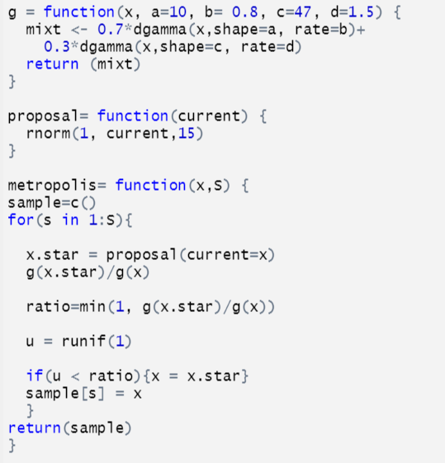

Metropolis implementation
The analysis was run on the assumption of a Gamma mixture model
Model specification:
$f\left(x\right)=0.3 dGamma \left(x;α=10, β=0.8\right)+$
$0.7 dGamma \left(x; α=47, β=1.5\right)$
A symmetric Gaussian proposal centered at the current state was used

Slide 28
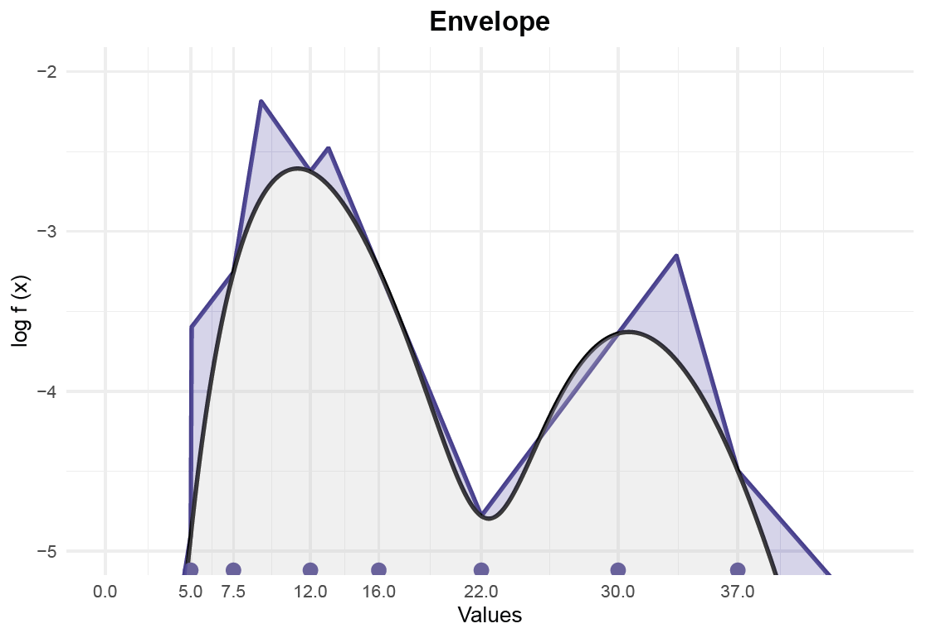

ARMS implementation
Model specification:
$f\left(x\right)=0.3 dGamma \left(x; α=10, β=0.8\right)+$
$$0.7 dGamma \left(x; α=47, β=1.5\right)$$
Not log-concave distribution requires the adaptive step to be introduced for efficient sampling.

Slide 29
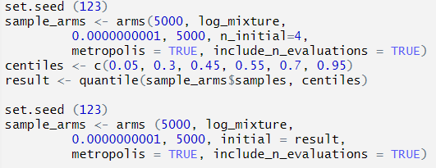
ARMS in R

Slide 30
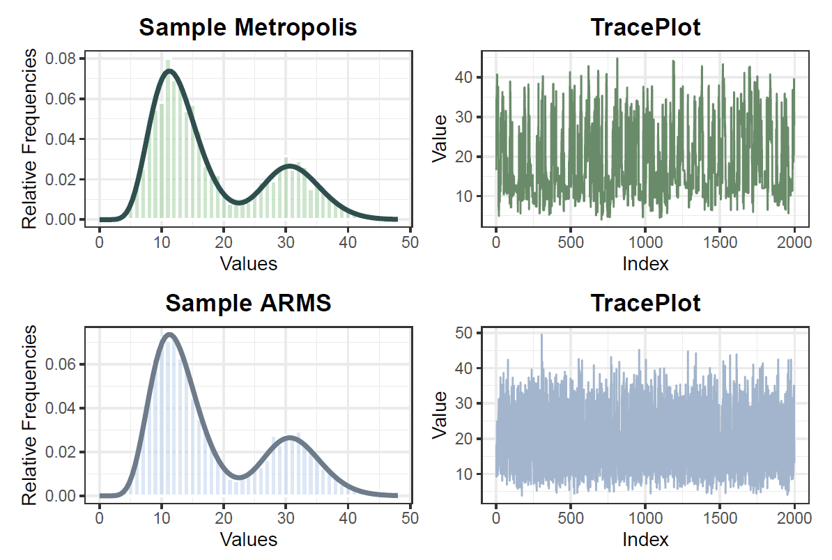
Output for ARMS
Method | Metropolis | ARMS
ESS | 621 | 5000
Lag 1 | 0.76 | 0.05
Lag 2 | 0.59 | 0
Lag 3 | 0.45 | -0.01
Lag 4 | 0.36 | -0.01
Lag 5 | 0.27 | -0.01
Lag 6 | 0.19 | 0.01
Lag 7 | 0.14 | 0
Lag 8 | 0.11 | 0
Lag 9 | 0.08 | 0.02
Lag 10 | 0.06 | -0.01

Slide 31
Result
When considering the complexity of the distribution, it becomes evident that the proposed distribution does not offer a satisfactory approximation of the target density, resulting in numerous rejections and consequently higher autocorrelation in the Markov chain. On the other hand, Adaptive Rejection Metropolis sampling adeptly adjusts the piecewise exponential envelope to closely match the target distribution, resulting in a low-autocorrelation chain that effectively approximates the target.

Slide 32
Discussion
ARMS provides a suitable framework for tackling complex distributions
However, the efficiency decreases as the severity of non-log-concavity increases, demonstrating a larger number of rejections
Over the recent years, improved methods have been suggested. Among them are:
ATRIMS: using a mixture of trapezoidal densities
ARMS2: using Lagrange interpolation polynomial of the second degree to build a piecewise quadratic envelope
Variance reducing Stochastic Gradient Langevin Dynamics.

Slide 33
Thank you for your attention!
Adaptive Rejection Metropolis sampling
Sara Corrà, Goar Shaboian

Slide 34
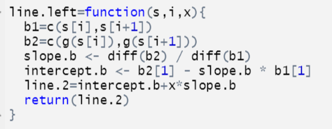
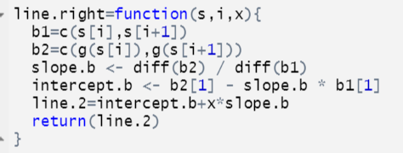
Left and right line function

